Slide 1

Picocell Analysis
Ansar Butt

Slide 2
Executive Summary
Problem
Is there an increase in the total traffic in the area where Picocells were deployed that can be attributed to addition of the Picocells?
Methodology
Dynamic Time Warping and Causal Impact are used to assess the impact of the Picocells on the area. These methods use a control group that is unaffected by the Picocells to predict the test group (in this case the area impacted by Picocells).
Results
There appears to be a 2% and 5% positive impact to downloads and uploads that can be attributed to Picocells, but to improve the confidence of this impact measure we should continue to collect Picocell data

Slide 3
Techniques Considered
To evaluate the picocell impact we treat this problem as an interrupted time series analysis, where the picocell installation is the “intervention”. These techniques were considered:
Techniques
Evaluation
Segmented regression model that compares slopes and intercepts of pre and post intervention periods.
Used in policy analysis where there are little time effects. Does not account for trend or seasonality.
Fit ARIMA model to pre-intervention data and forecast the post-intervention period. Compare prediction to post-intervention actuals.
Relies on rigorous tuning of moving averages, differencing and lags. Uses prior test data to predict future.
Causal Impact¹ analysis that constructs a Bayesian structural time series model using other macro site data to predict the Picocell data.
Assesses impact based on actual behaviour of a control series. Can visually inspect the underlying components of the model including unobserved trend and seasonality.
¹ CausalImpact 1.2.1, Brodersen et al., Annals of Applied Statistics (2015). http://google.github.io/CausalImpact/

Slide 4
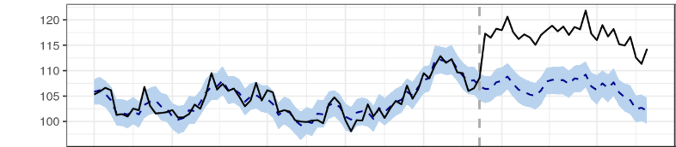
Causal Impact Process
Identify pre and post intervention periods
1
Pre-intervention period
Post-intervention period
2016
Jan 1st
July 10th
July 18th
Sept 29th
Specify a test and control group
2
Test Group: Picocells + macro sites in the immediate nearby area overlapping with the Picocells
Control Group: Other macro sites excluding those overlapping with the Picocells
Train model on pre-intervention data
3
Train
Bayesian Time Series Model
Predict
Control Group Data
Test Group Data
Predict post-intervention period with trained model
4
Pre-intervention
Actuals
Example Data
Predictions
Post-intervention

Slide 5
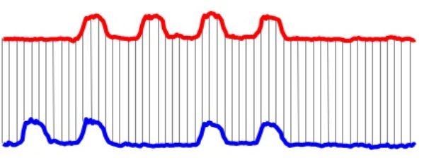
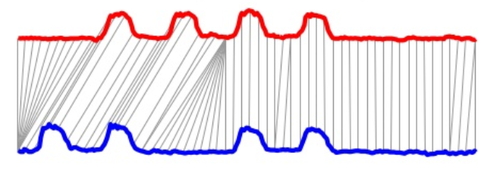
Control Group Selection
Causal Impact assumes control macro sites are similar or correlated to the test site.
There are 93 control macro sites to choose from – how do we choose the most similar sites?
Dynamic Time Warping (DTW)
Euclidean Distance
DTW
One to one distance measure based on the existing alignment of the sequence. Does not capture temporal shifts.
One to many distance measure that can capture non-linear alignments and account for shifts in time.
With DTW, we can find the control macro sites that most match the test site over time
Images from: https://www.slideshare.net/Henry_cu/eage2012-dtw-hvdb

Slide 6
Assumptions
Post-intervention period begins on July 18th, or 7 days after the initial deployment date
The control groups selected were not affected by the intervention
The relationship between control group and test group, as established during the pre-period, remains stable throughout the post-period
DTW assumes that the time series of one vector (macro site) can be non-linearly transformed from another macro site

Slide 7
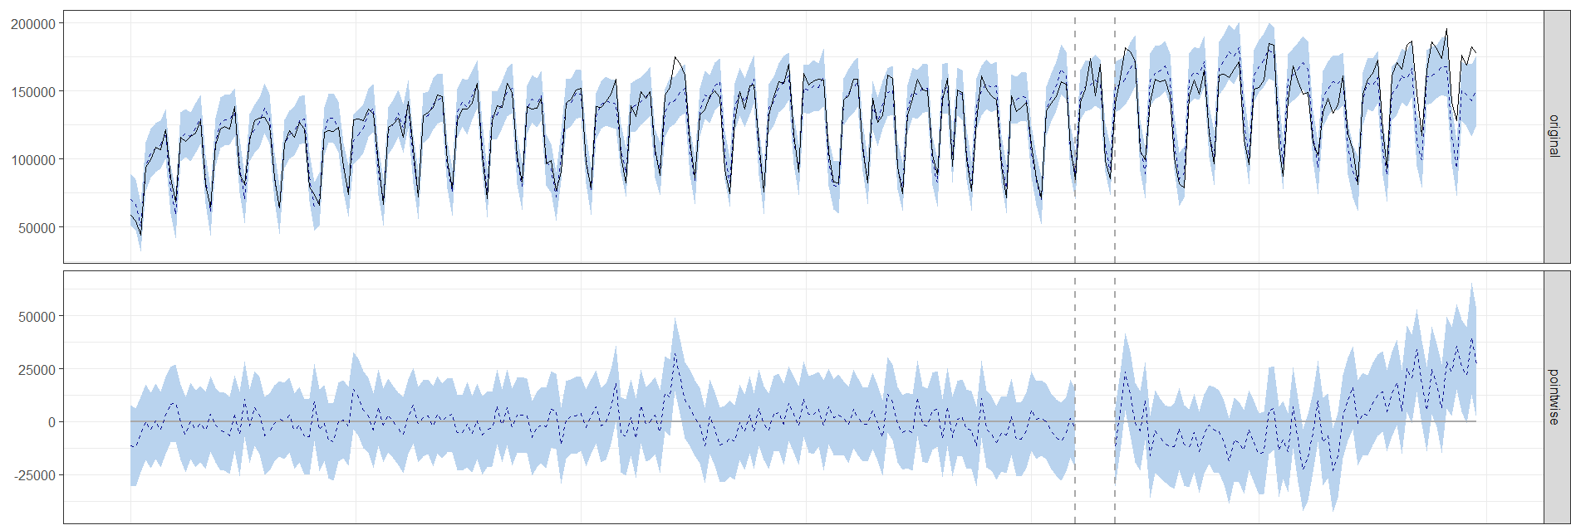
Results - Downloads
Training Period
Prediction Period
Actuals Prediction
The increase is 2% with a 95% interval of [-2%, +7%]
Although the intervention appears to have caused a positive effect, this effect is not statistically significant
The intervention period is too small to distinguish the Picocells effect from the noise with confidence
Actuals: Download volume after the Picocells were installed
Predicted: Predicted download volume assuming Picocells were not installed
Difference: Impact of Picocells on download volume
Recommendation: continue collecting data from the Picocells to have more confident results

Slide 8
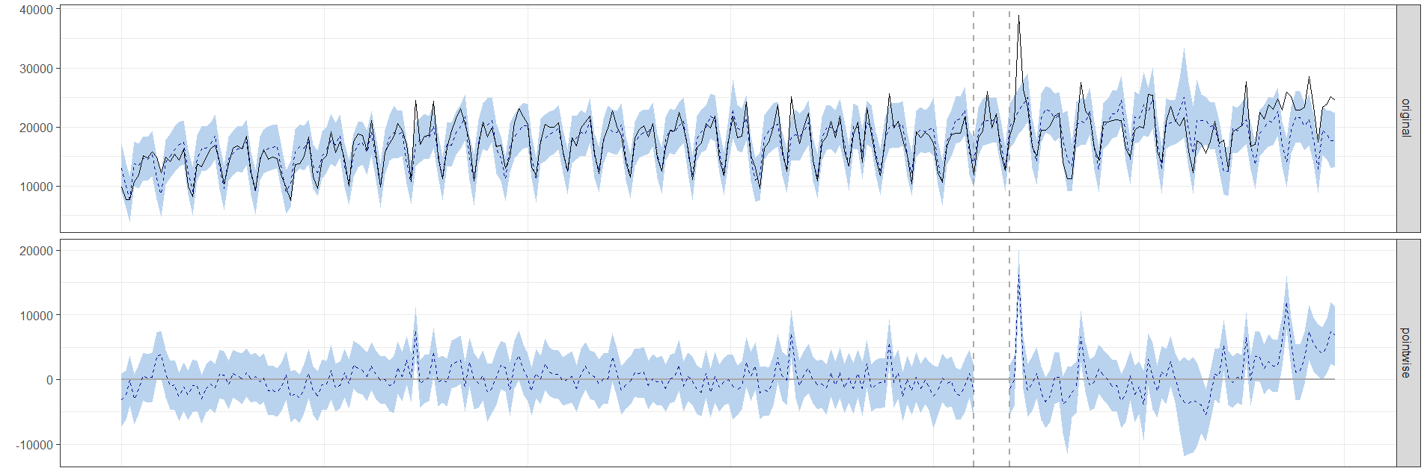
Results - Uploads
Training Period
Prediction Period
Actuals Prediction
The increase is 5% with a 95% interval of [-2%, +12%]
Although the intervention appears to have caused a positive effect, this effect is not statistically significant
The intervention period is too small to distinguish the Picocells effect from the noise with confidence
Actuals: Upload volume after the Picocells were installed
Predicted: Predicted upload volume assuming Picocells were not installed
Difference: Impact of Picocells on upload volume
Recommendation: continue collecting data from the picocells to have more confident results

Slide 9
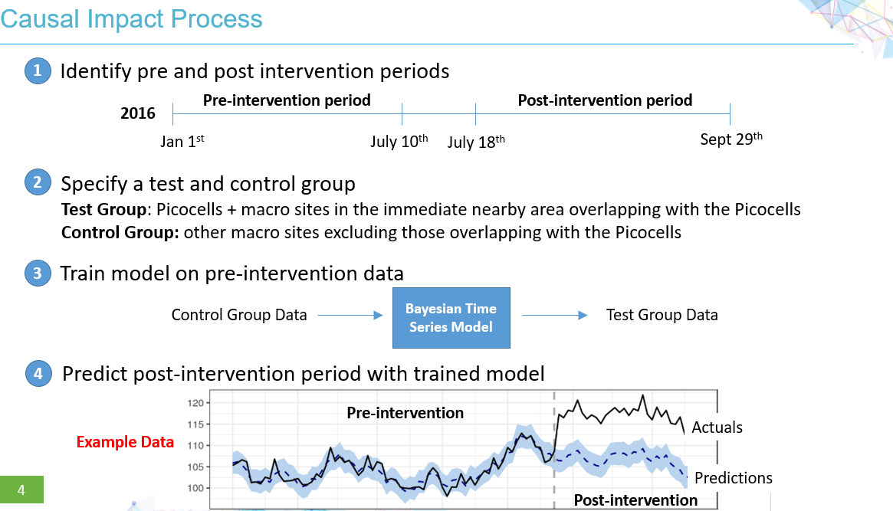
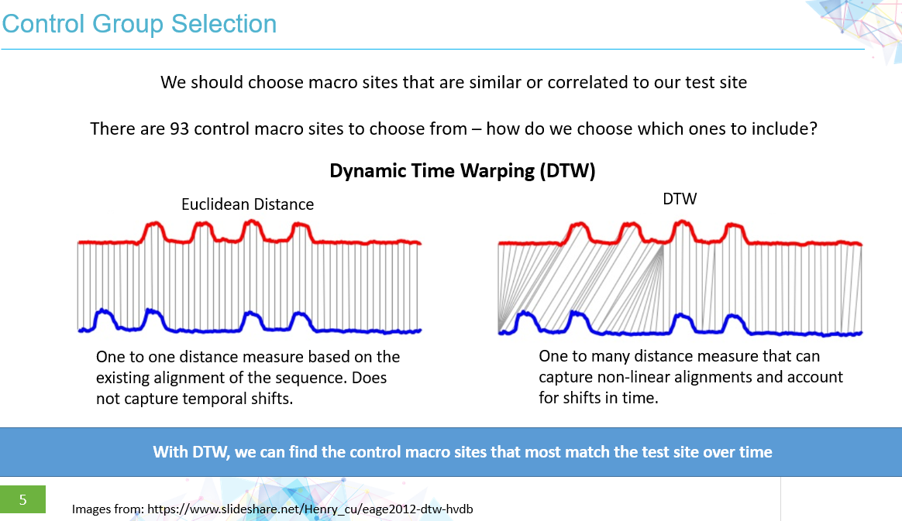
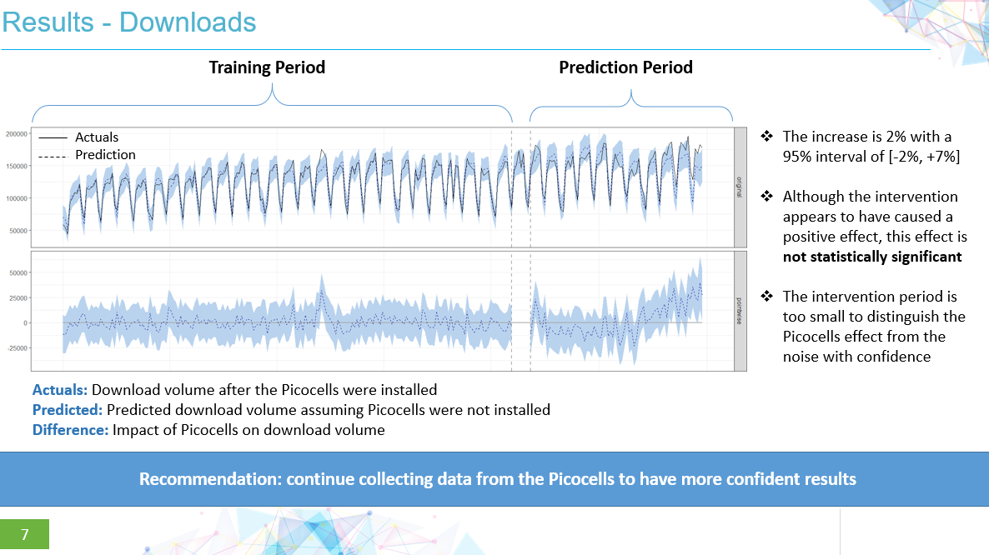
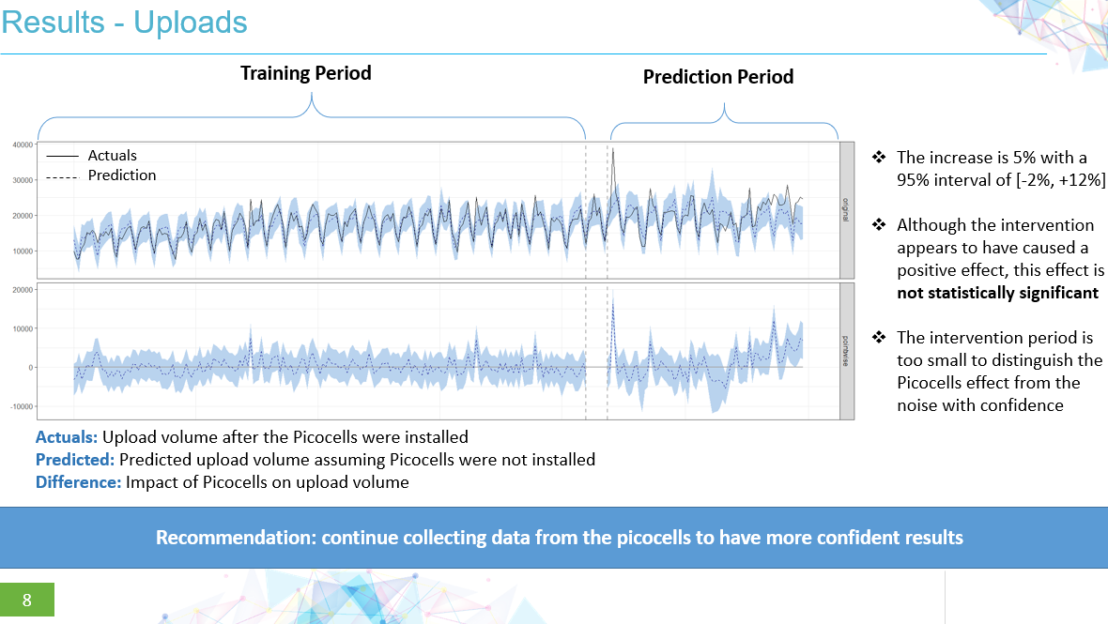
Summary

Slide 10
APPENDIX

Slide 11
Appendix – Report for the Downloads
During the post-intervention period, the response variable had an average value of approx. 146.21K. In the absence of an intervention, we would have expected an average response of 142.65K. The 95% interval of this counterfactual prediction is [136.34K, 148.63K]. Subtracting this prediction from the observed response yields an estimate of the causal effect the intervention had on the response variable. This effect is 3.56K with a 95% interval of [-2.42K, 9.87K]. For a discussion of the significance of this effect, see below.
Summing up the individual data points during the post-intervention period (which can only sometimes be meaningfully interpreted), the response variable had an overall value of 10.82M. Had the intervention not taken place, we would have expected a sum of 10.56M. The 95% interval of this prediction is [10.09M, 11.00M].
The above results are given in terms of absolute numbers. In relative terms, the response variable showed an increase of +2%. The 95% interval of this percentage is [-2%, +7%].
This means that, although the intervention appears to have caused a positive effect, this effect is not statistically significant when considering the entire post-intervention period as a whole. Individual days or shorter stretches within the intervention period may of course still have had a significant effect, as indicated whenever the lower limit of the impact time series (lower plot) was above zero. The apparent effect could be the result of random fluctuations that are unrelated to the intervention. This is often the case when the intervention period is very long and includes much of the time when the effect has already worn off. It can also be the case when the intervention period is too short to distinguish the signal from the noise. Finally, failing to find a significant effect can happen when there are not enough control variables or when these variables do not correlate well with the response variable during the learning period.
The probability of obtaining this effect by chance is p = 0.129. This means the effect may be spurious and would generally not be considered statistically significant.

Slide 12
Appendix – Report for the Uploads
During the post-intervention period, the response variable had an average value of approx. 20.47K. In the absence of an intervention, we would have expected an average response of 19.53K. The 95% interval of this counterfactual prediction is [18.17K, 20.84K]. Subtracting this prediction from the observed response yields an estimate of the causal effect the intervention had on the response variable. This effect is 0.95K with a 95% interval of [-0.37K, 2.30K]. For a discussion of the significance of this effect, see below.
Summing up the individual data points during the post-intervention period (which can only sometimes be meaningfully interpreted), the response variable had an overall value of 1.52M. Had the intervention not taken place, we would have expected a sum of 1.45M. The 95% interval of this prediction is [1.34M, 1.54M].
The above results are given in terms of absolute numbers. In relative terms, the response variable showed an increase of +5%. The 95% interval of this percentage is [-2%, +12%].
This means that, although the intervention appears to have caused a positive effect, this effect is not statistically significant when considering the entire post-intervention period as a whole. Individual days or shorter stretches within the intervention period may of course still have had a significant effect, as indicated whenever the lower limit of the impact time series (lower plot) was above zero. The apparent effect could be the result of random fluctuations that are unrelated to the intervention. This is often the case when the intervention period is very long and includes much of the time when the effect has already worn off. It can also be the case when the intervention period is too short to distinguish the signal from the noise. Finally, failing to find a significant effect can happen when there are not enough control variables or when these variables do not correlate well with the response variable during the learning period.
The probability of obtaining this effect by chance is p = 0.085. This means the effect may be spurious and would generally not be considered statistically significant.

